Slide 1







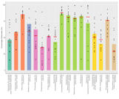

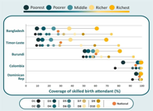
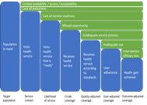
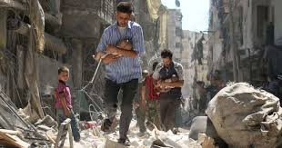
The Plausibility of Routine Health Management Information Systems in Monitoring Health Services Coverage and Mortality in Somalia
Presenter: Osman Hassan Osman
Notes:
This article discusses how to assess the accuracy and reliability of the data provided by the Somali HMIS, particularly in terms of coverage of health services (such as maternal and child health, vaccination, etc.) and population demographics.
Si loo monite gareyo health service coverage in Somalia MM

Slide 2
Introduction
HMIS is one of the health system building blocks for EPHS.
It is essential for monitoring health service coverage and mortality and supports data-driven decisions in Somalia.
In the absence of surveys, could be used to generate coverage estimates
We show the possibilities of using Somalia DHIS-2 data in generating RMNCH coverage estimate, including maternal Mortality.
Notes:
Steps
1.We diffened the HMIS
2.The objectives of these study is to show that the pos….

Slide 3
Countdown 2030 Analytical approach
1
Compile and standardize monthly regional level data
1. Reporting completeness
2. Consistency
3. Outliers and missings
DQ report
Card (checks.xlxs)
2
Run data quality checks
1. Adjustment for completeness
2. Correction with a clear audit trial
3. Correction of outliers & missings
District & Primary Admin Unit Profiles for
Annual Reviews
3
Correct dataset
Clean dataset for analysis
(master_Adj_dataset.dta)
4
Analyze health service volume (level, difference, trends, etc.)
Numerator coverage
Calculate denominator
Health service derived denominator (e.g., from ANC1, DPT1)
Population derived denominator (e.g., from CBR, live births)
5
Denominator coverage
6
Calculate health service coverage
Coverage of health service
Health service coverage
Notes:
Steps:
We compile
To use the hmis for the main objectives we are going to fallow countdown an…
Once we clean the data Quality we start to work on the analysis
In Somalia Its easier ti use for the health service coverage derived to the denominator

Slide 4
Indicators
Maternal
ANC 1st visit
ANC1 first trimester
ANC 4th visit
Delivery, facilities
SBA
C-section
Immunization
BCG
Penta3
Measles1 (MCV1)
Deaths in facilities
Stillbirths (fresh, macerated, total)
Maternal deaths
Neonatal deaths
Population
Total population
Total under-1
Total under-5
Total births
Total live births
Total women 15-49 years
Annual population growth rate
Notes:
For these study we selected the fallowing indicators to reach this, we worked on data quality checks

Slide 5
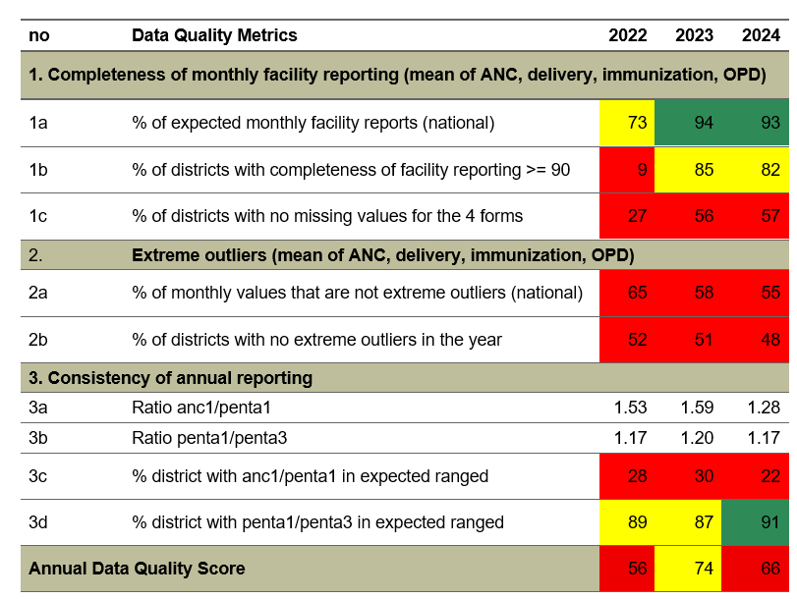
Step 1: Data quality assessment
- Missing data for 2019-2021
- ANC-1 not strongly matching Penta-1
Facility reporting has improved
Poor recording
  Missingness of the values within the data elements
  Implausible values – outliers
  Inconsistence between the relates indicators, for instance, Penta-1/Penta-3.
Notes:
Green colour : it means that there is good progress to achieved in our target with results more than 90
Yellow colour :shows that the quality of the data inprogress to achieve our target
But the red colour indicators that the quality of the data is not obtimal but we are currently working to reach hight level

Slide 6
Step 2- Assessment and selection of the indicators

Slide 7
Coverage Trends in Penta3 & Measles 1
DHIS2 Estimates closely related to DHS estimate, indicating reliability of DHIS2
Possibilities of over-estimates of WEUNIC reported figures
Nevertheless, both CD2030 and WEUNIC show sub-optimal coverage estimates
Close to 8 over 10 children have incomplete Penta-3 and Measles-1 vaccine
Notes:
PENTA3 coverage the graph contains dhis2 survey estimate and also wuenic while the second one is measles 1

Slide 8
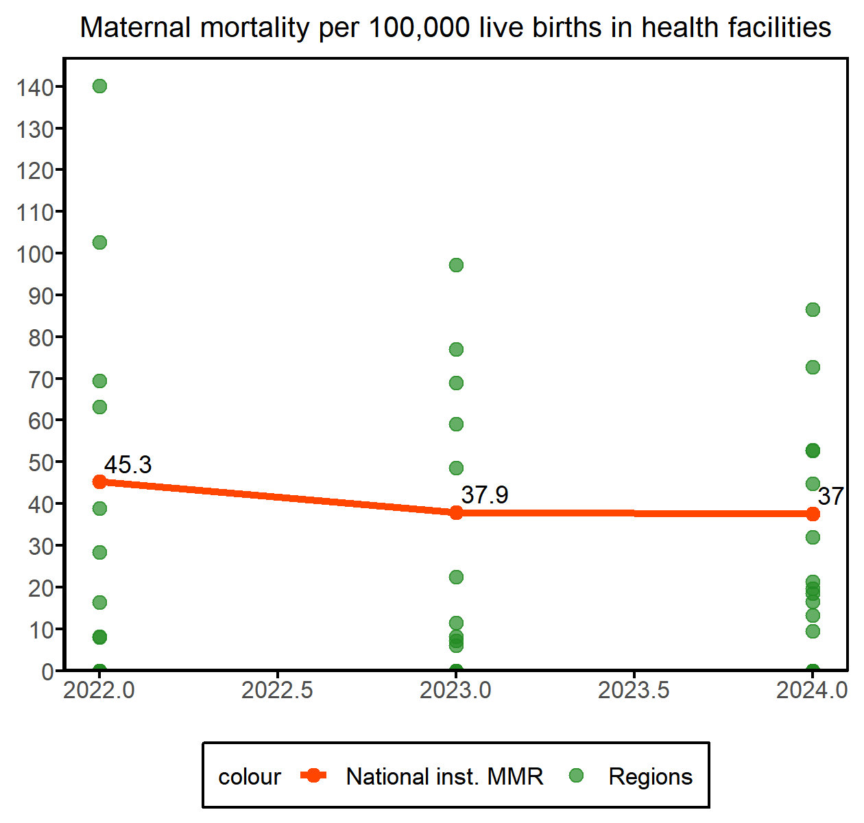
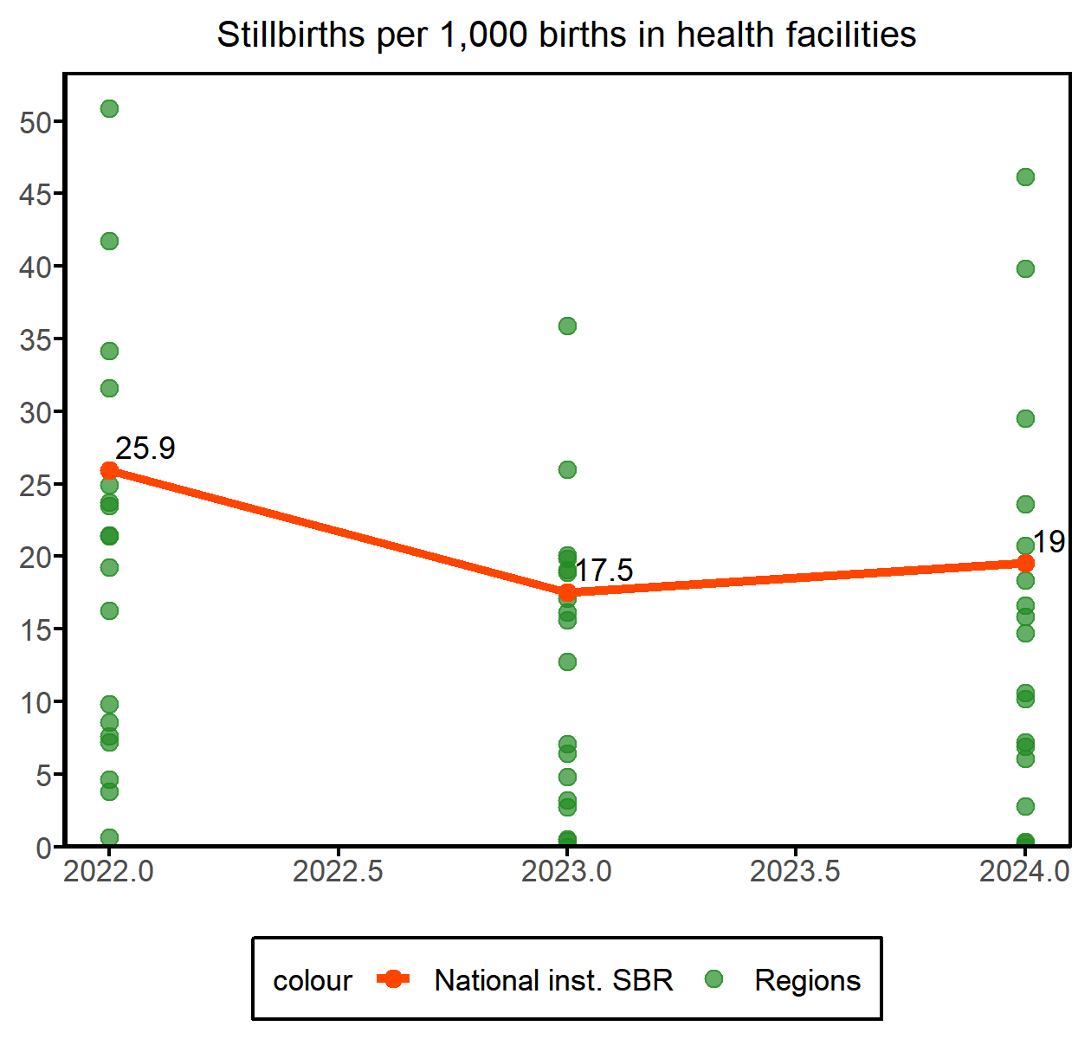
Maternal Mortality

Slide 9
Conclusions
With increased reporting and data quality, HMIS can be used for monitoring health services coverage
Both survey and HMIS coverage estimates show persistent low coverage in maternal and immunization services
Maternal and perinatal mortality are high in reporting health facilities
Underreporting is expected
Strengthening data quality assurance, validation mechanisms, and harmonization across data sources is essential to enhance the accuracy and credibility of health information in Somalia.
Notes:
1.Increasing the reporting HMIS and quality of the data
2. Both survey and routine HMIS Data shows persistent low coverage In maternal and immunizations
3.MMR is still Hight in reporting Health Faciliites
4. Underreporting
5.

Slide 10




Thank you
@aphrc
@Countdown2030
www.aphrc.org www.countdown2030.org

