Slide 1




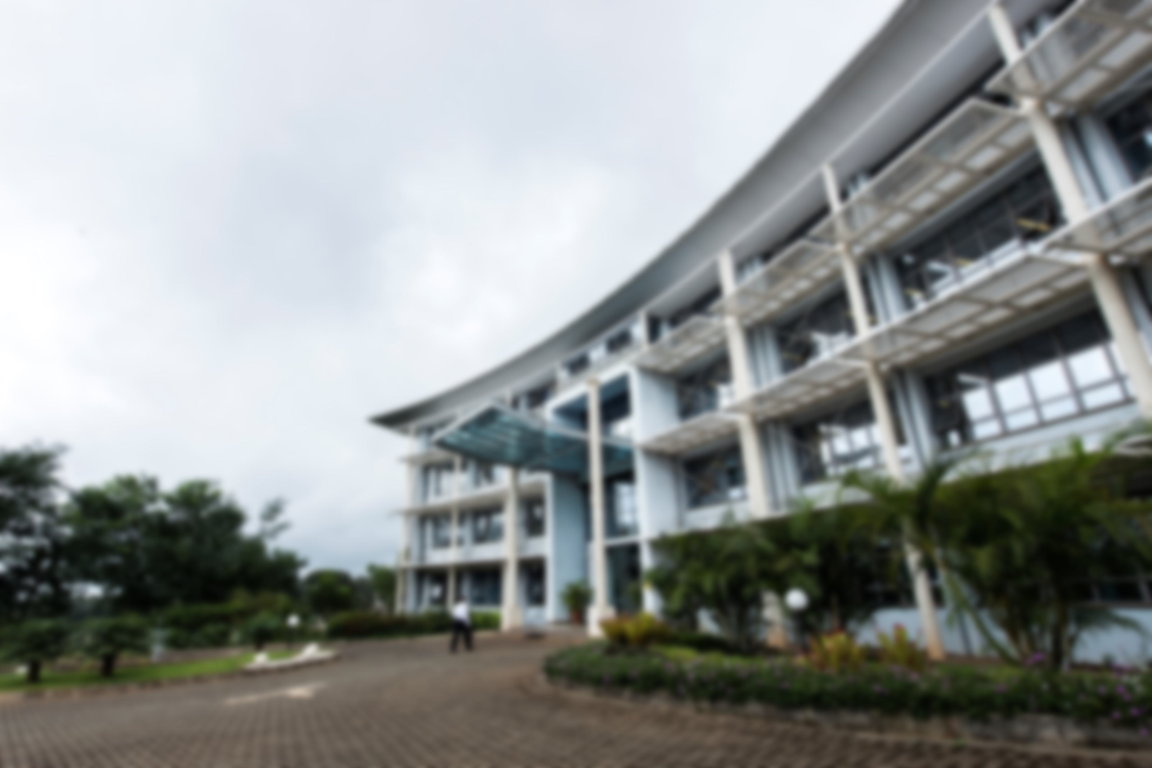

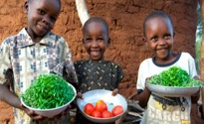
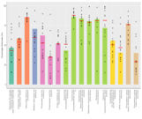
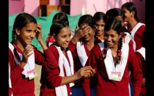
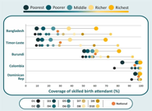
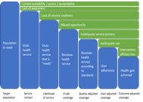
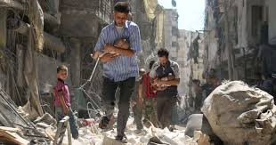
Disparities in Childhood Immunizations and VPD Outbreaks in Somalia
Presenter: Ahmed M Hussein

Slide 2
Background
Immunization is a core public health interventions for preventing common child illnesses, including diarrhoea, pneumonia, diptheria, measles, etc
In Somalia, childhood immunization and VPD are shaped by socioeconomic status, maternal education, and place of residence (urban, rural, nomadic).
We examine the inequality in immunization coverage and assess the distribution of VPD across regions
Notes:
Immunization stands as a cornerstone of public health, acting as a primary strategy for preventing contagious childhood diseases and averting an estimated two to three million deaths each year.
However, a significant gap remains in achieving global vaccination targets.
Inequalities arise from—and reinforce—social gradients in education, residence, and household resources; across low- and middle-income countries, children from wealthier families are consistently more likely to be vaccinated than those from poorer households.
These inequities elevate outbreak risk, sustain transmission in pockets of low coverage, and blunt progress toward SDG 3 and IA2030 goals.

Slide 3
Methods
Immunization coverage data for children aged 12–23 months were obtained from the (SHDS) 2020.
(VPD) case data were extracted from the DHIS2/IDSR routine surveillance system, covering two years from April 2023 to September 2025.
Notes:
CD2030 DQA issues: Completness, consistency , outliers and missingness

Slide 4
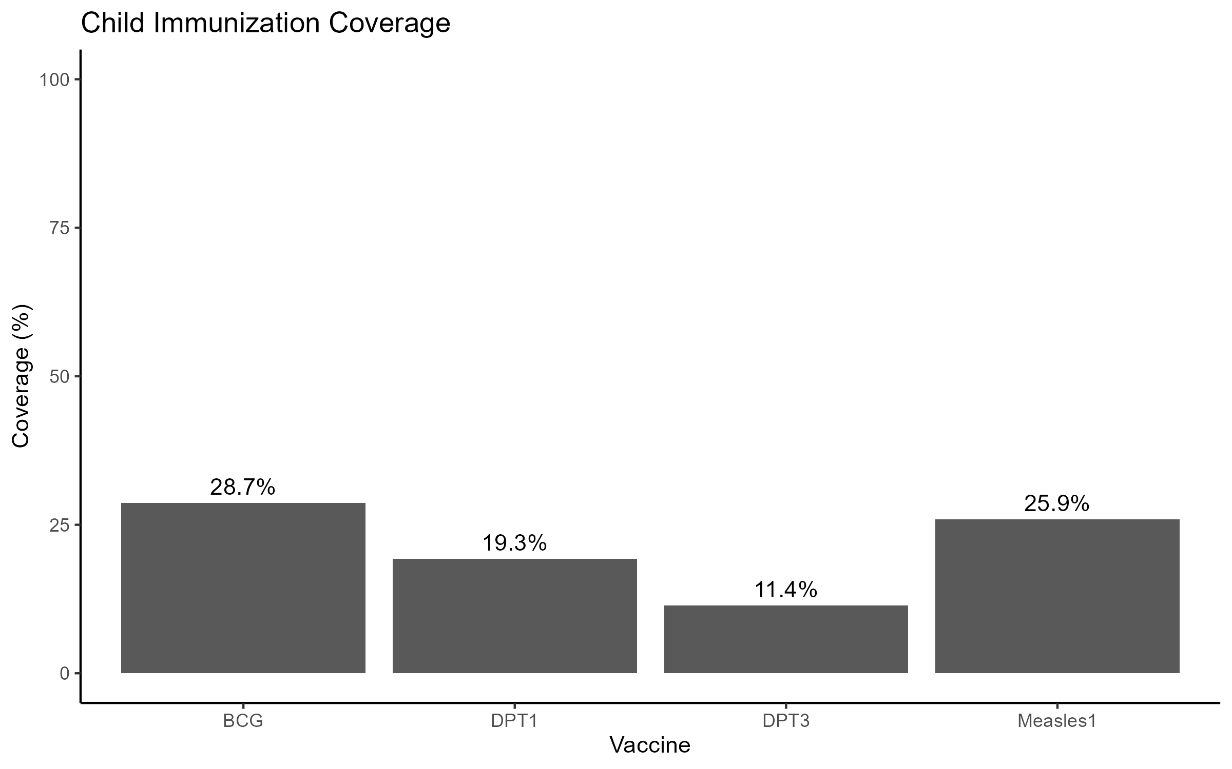
Results

Slide 5
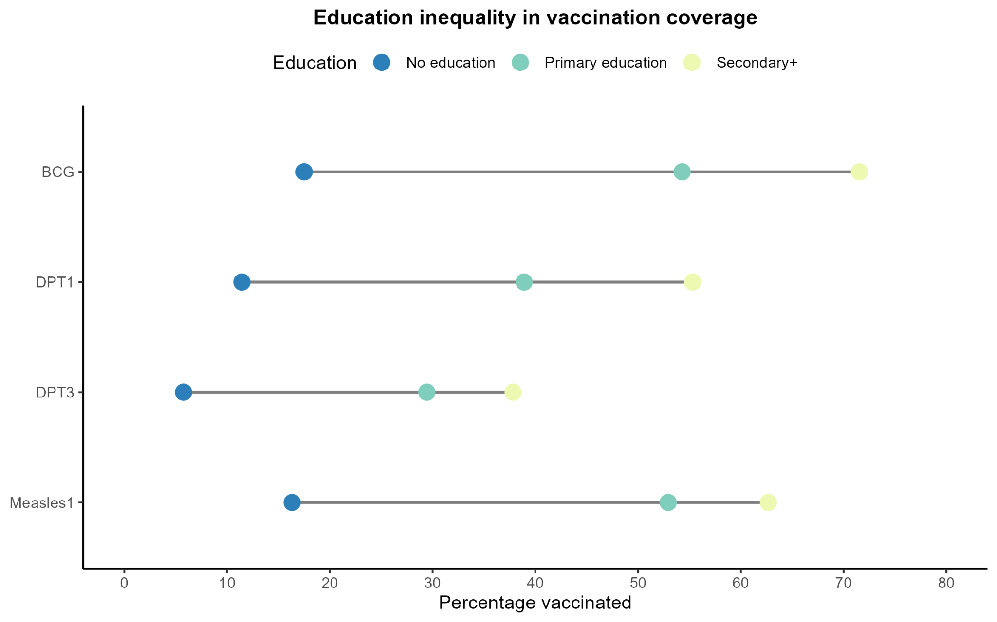
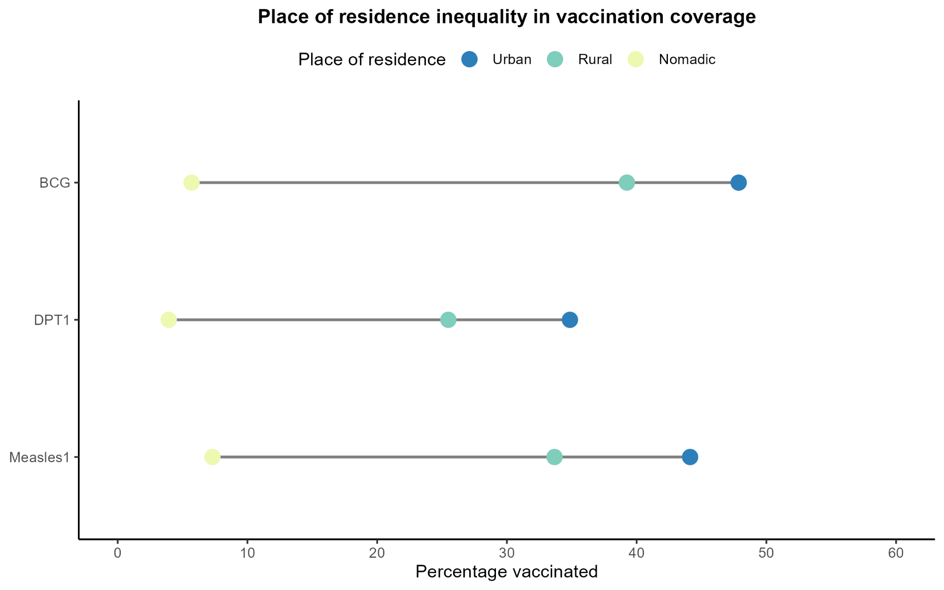
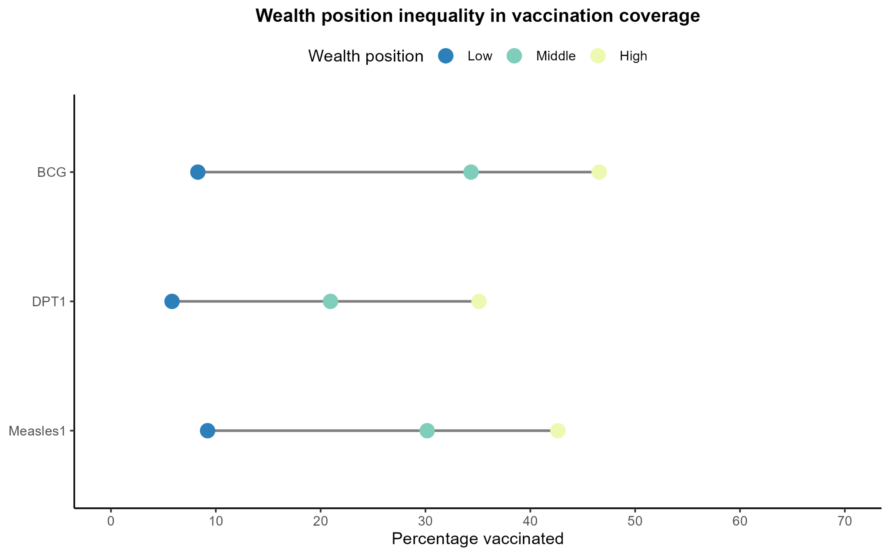
Inequalities in Childhood Immunization
Access is high among highly education, residing in less poor household and urban.
However, access to service among all remains sub-optimal.
Notes:
1-Vaccination coverage increases strongly with maternal education
2-Children in urban areas are significantly more likely to be vaccinated
than those in rural and nomadic settings,.
3-Vaccination coverage rises across wealth tiers(more previlged than
those with less previleged).

Slide 6
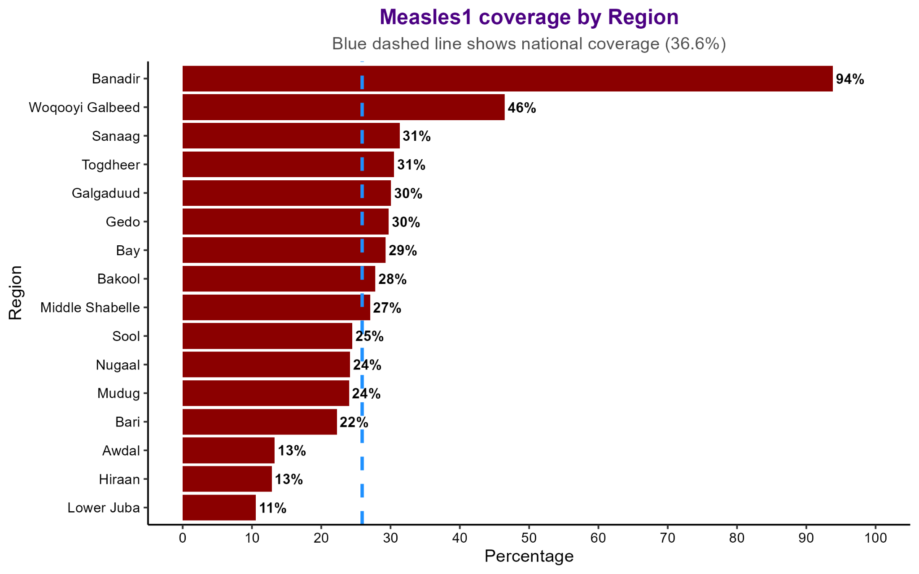
Regional Inequalities in Measles-1 vaccine Coverage (SHDS 2020) and measles outbreak
Region | Suspected measles case | %ge share
Benadir | 8346 | 24.7
Lower Juba | 4271 | 12.6
Bay | 4061 | 12.0
Mudug | 2806 | 8.3
Middle Shebelle | 2063 | 6.1
Galgadud | 2020 | 6.0
Bakool | 1823 | 5.4
Gedo | 1612 | 4.8
Hiiraan | 1130 | 3.3
Nugaal | 859 | 2.5
Bari | 198 | 0.6
Sanaag | 72 | 0.2
Sool | 6 | 0.0
Measles-1 coverage is higher in Banadir
There is a high number of suspected measles case in the last 3 years
We hypothesize that the outbreaks could be a result sub-optimal coverage of measles vaccination

Slide 7
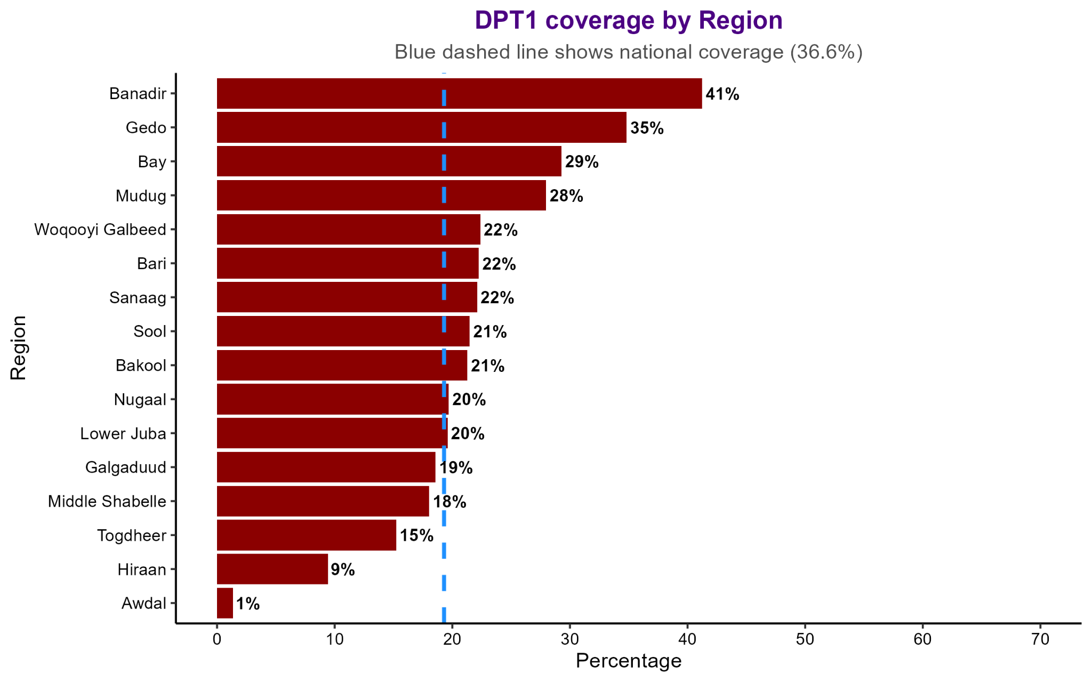
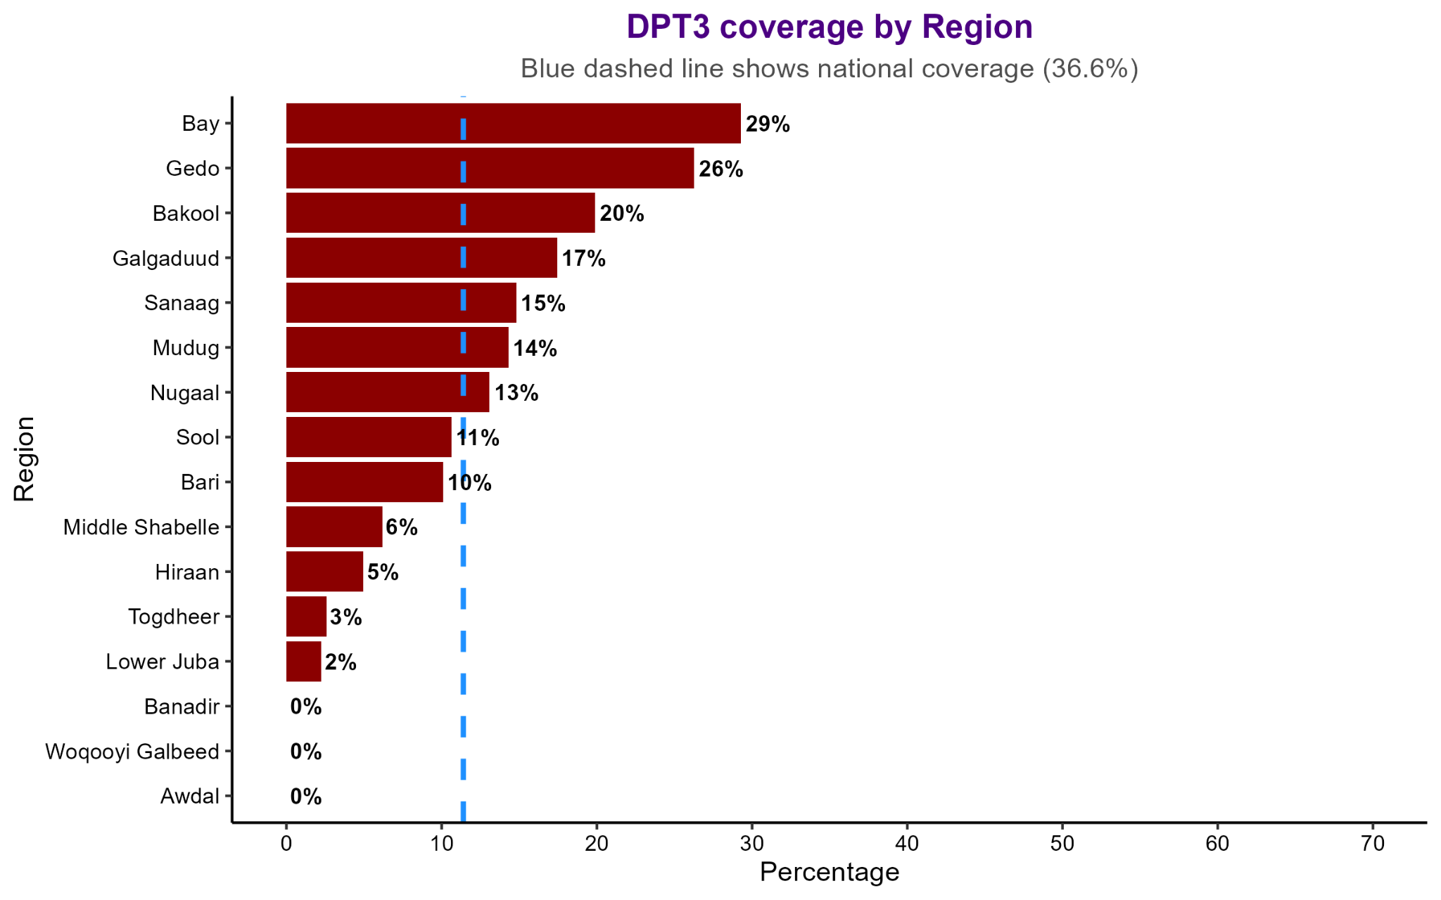
Regional Inequalities in DPT Coverage and outbreaks in the last 3 years (2023-2024)
Region | Whooping cough and diptheria | %ge share
Bay | 4864 | 15.3
Benadir | 3597 | 11.3
Mudug | 2998 | 9.4
Lower Juba | 2580 | 8.1
Middle Shebelle | 2571 | 8.1
Gedo | 2343 | 7.4
Bakool | 2318 | 7.3
Hiiraan | 2060 | 6.5
Galgadud | 2042 | 6.4
Nugaal | 1330 | 4.2
Bari | 719 | 2.3
Sanaag | 529 | 1.7
Sool | 382 | 1.2
Poor coverage of DPT
There is a high number of suspected whooping cough and diphtheria years
We hypothesize that the outbreaks could be a result sub-optimal coverage of measles vaccination

Slide 8
Conclusion
Routine immunization coverage remains far below the expected global and national coverage
Emerging of suspected outbreaks for VPDs, which have been eleminated in other countries
We suggest Strengthening routine immunization systems through:
expanding outreach to underserved populations
improving child service integration within the other services

