Slide 1


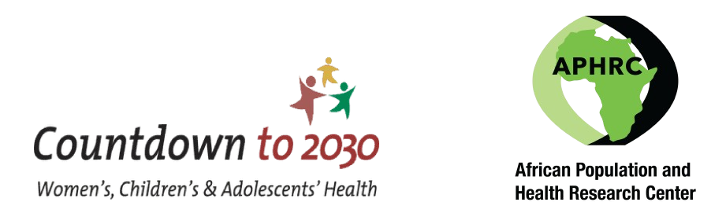




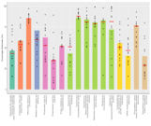

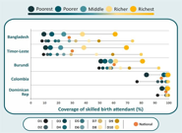
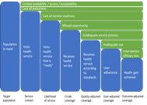
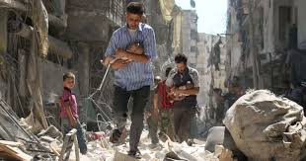
Epidemiology of maternal and newborn health in Somalia: service coverage, equity and mortality
Presenter: Mohamed Daud Mohamud

Slide 2
Introduction
Persistent high mortality rates and inadequate service coverage.
The maternal mortality ratio is 692 deaths per 100,000 live births, (SHDS, 2020).
There is a need to understand the inequalities in maternal and newborn health service coverage
Understand how these relate to maternal and newborn outcomes: morbidity and Mortality.
Addressing these disparities is crucial for improving health outcomes to align with the sustainable development goals.
We assess the coverage and inequality of maternal and newborn health services in Somalia
Examine how regional performance disparities are associated with maternal and perinatal mortality, and neonatal tetanus.

Slide 3
Methodology
This is a secondary analysis of Somalia's DHIS2 (2022-2024) and the 2020 SHDS to assess maternal and newborn health.
Use equiplots to show the inequality in maternal and newborn services across key stratifiers

Slide 4
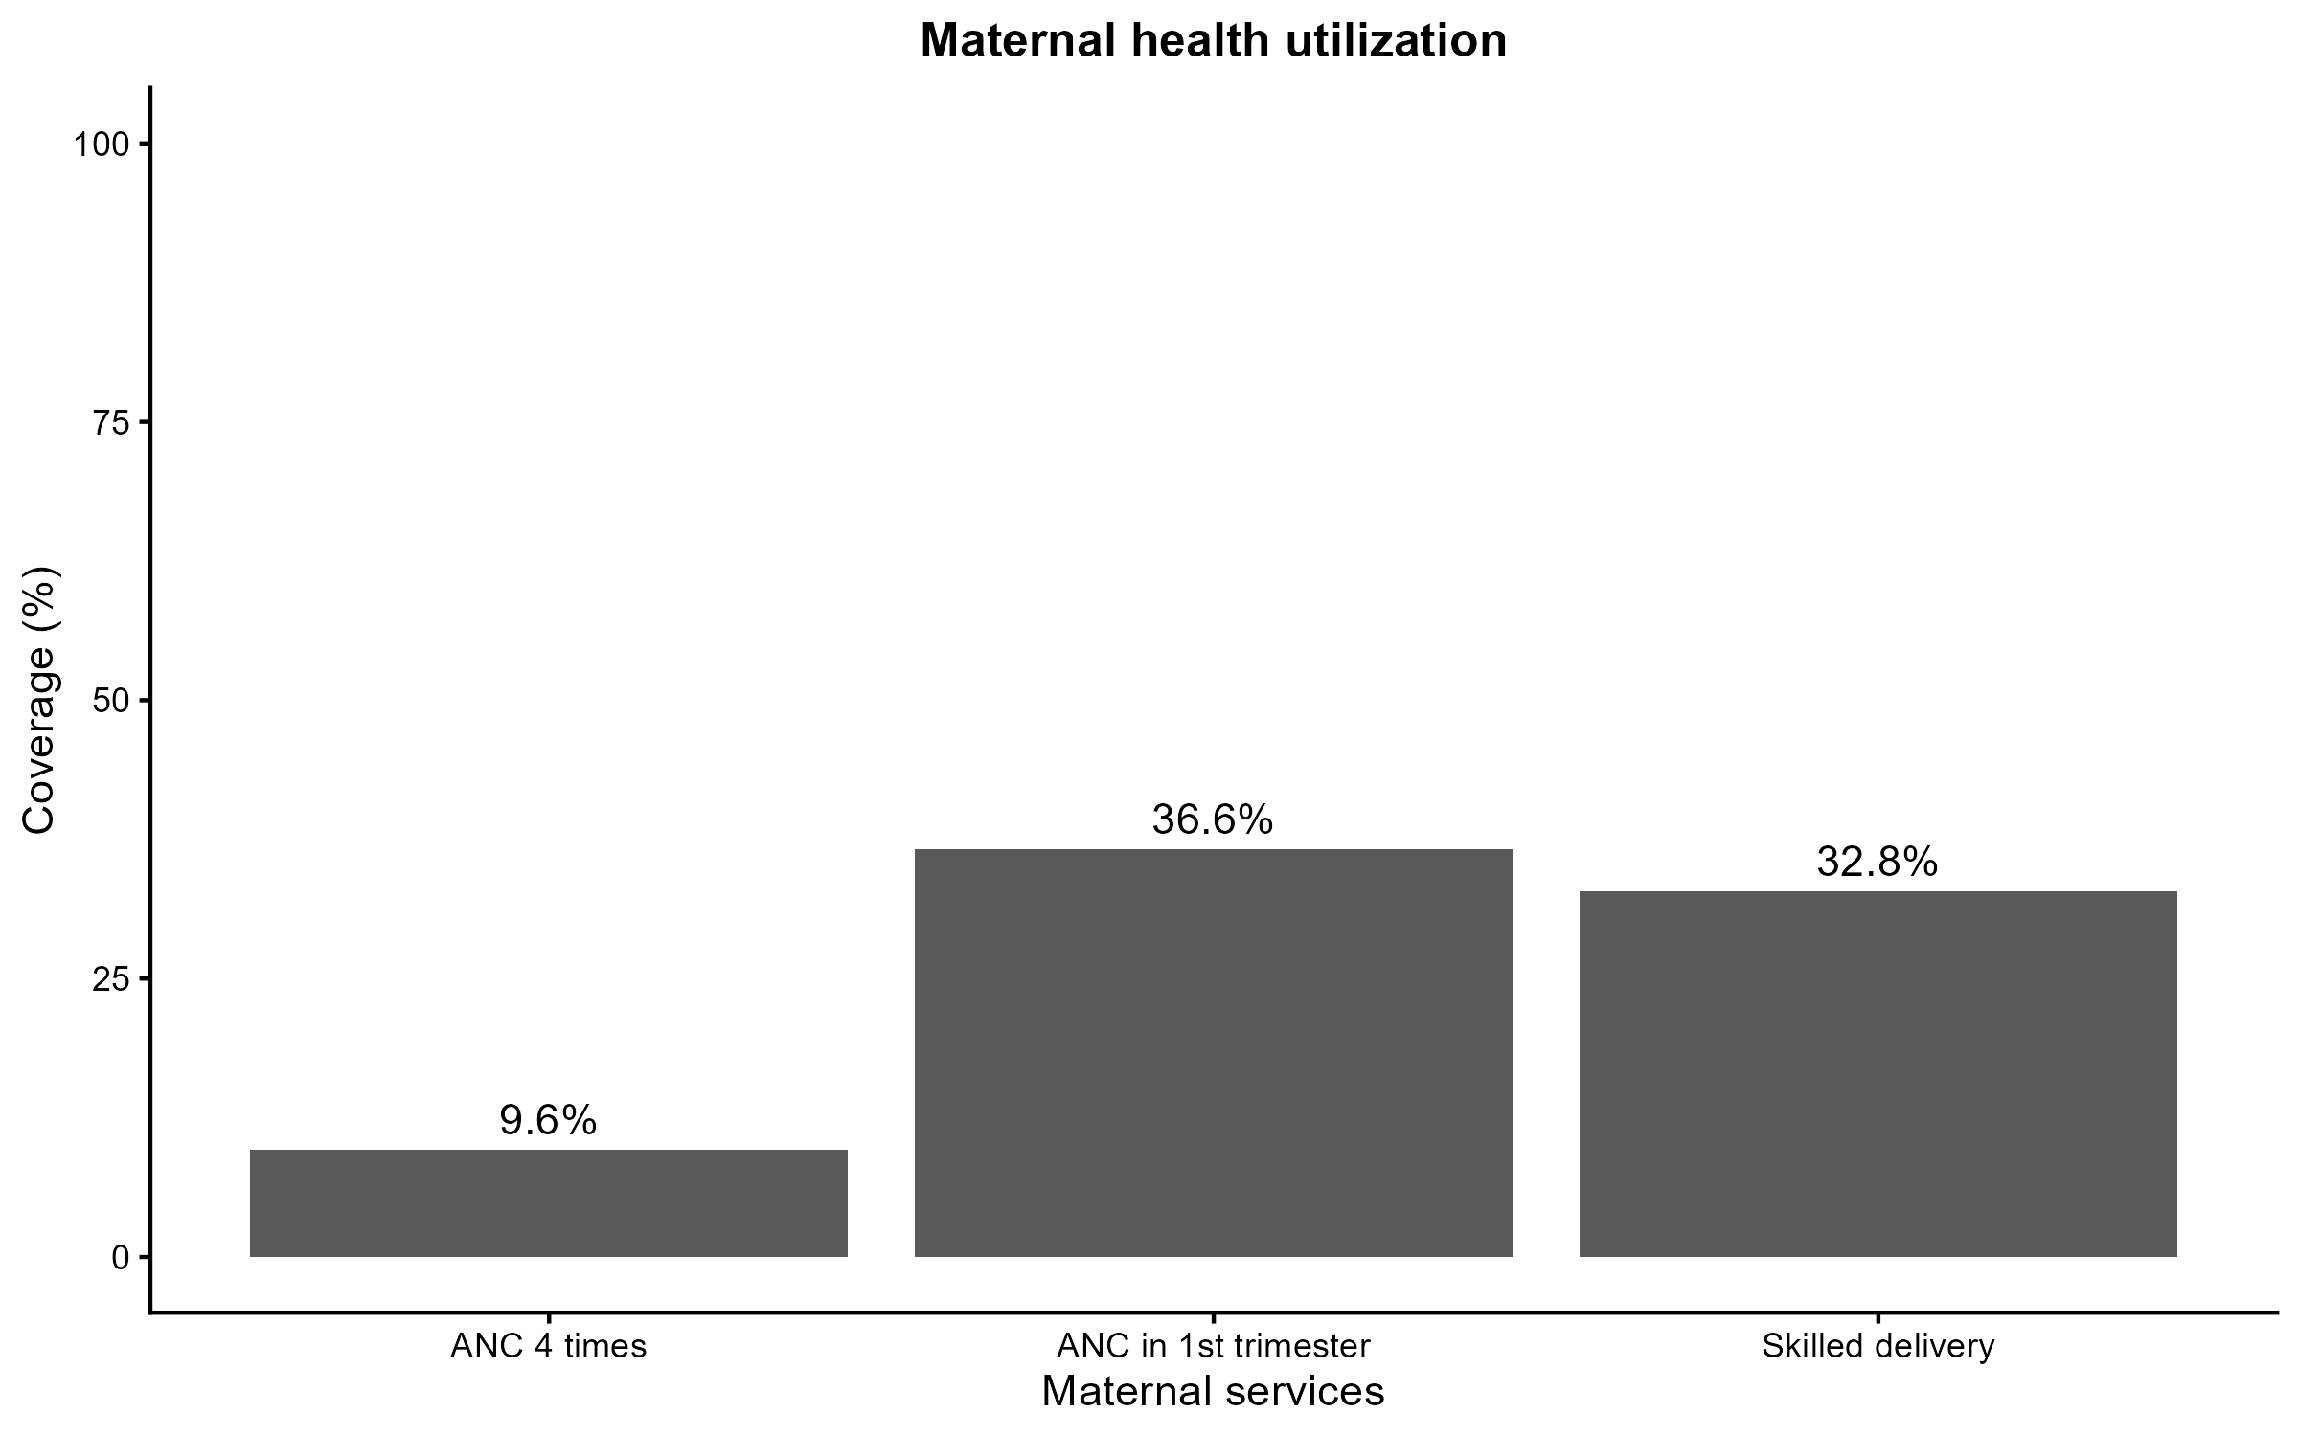
Results: maternal health utilization

Slide 5
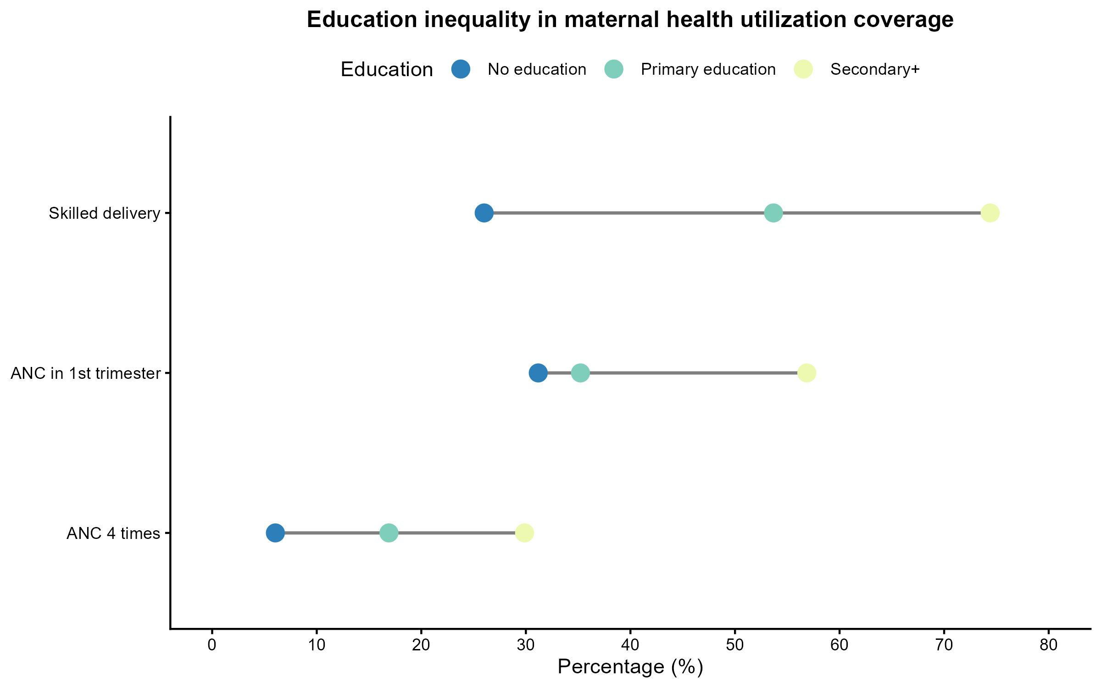
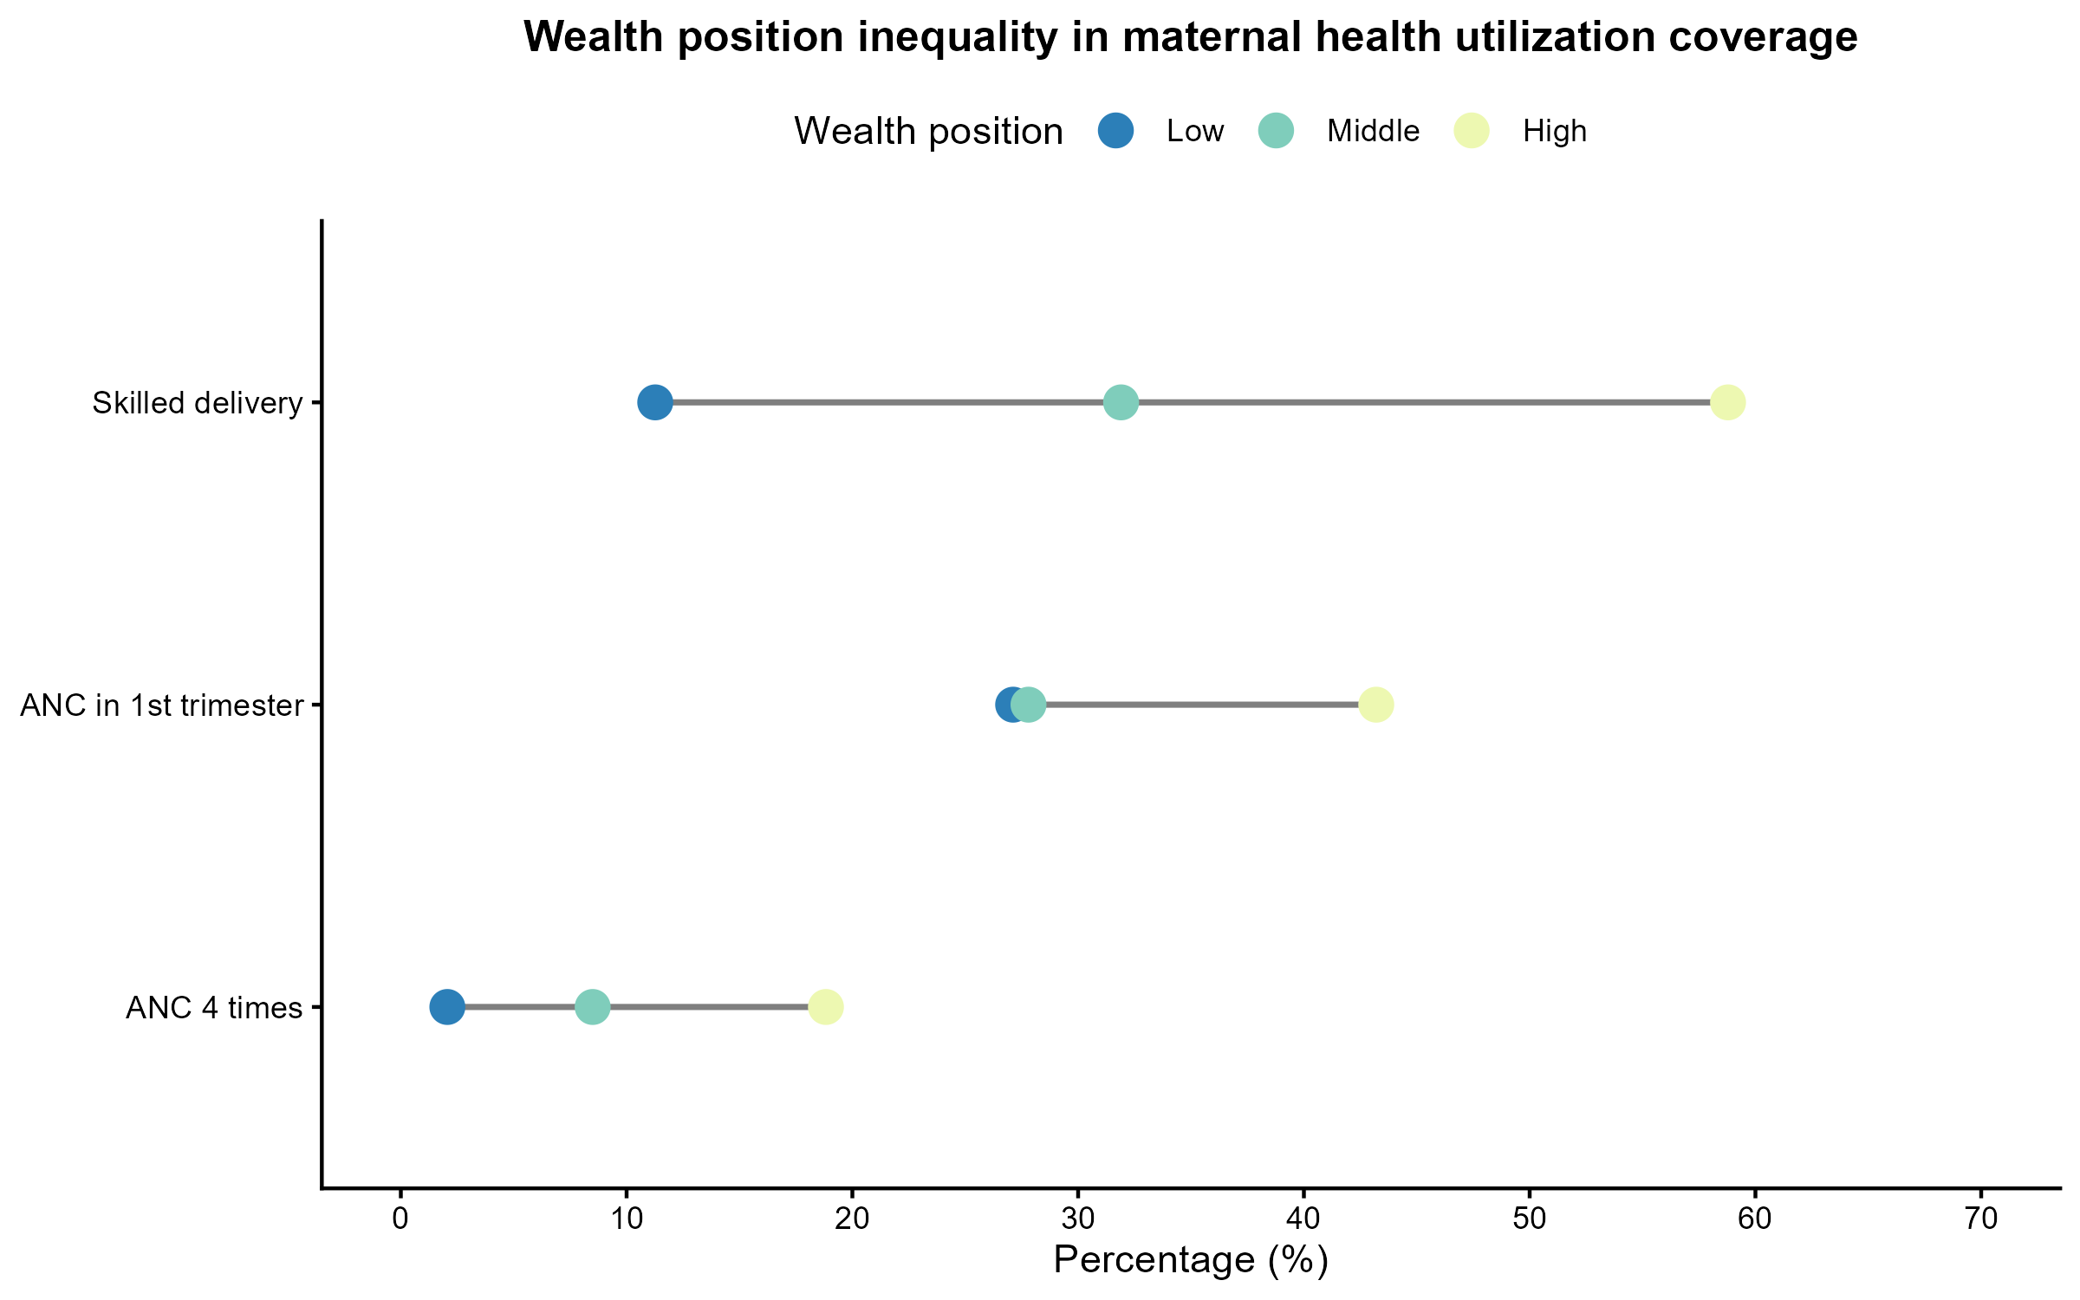
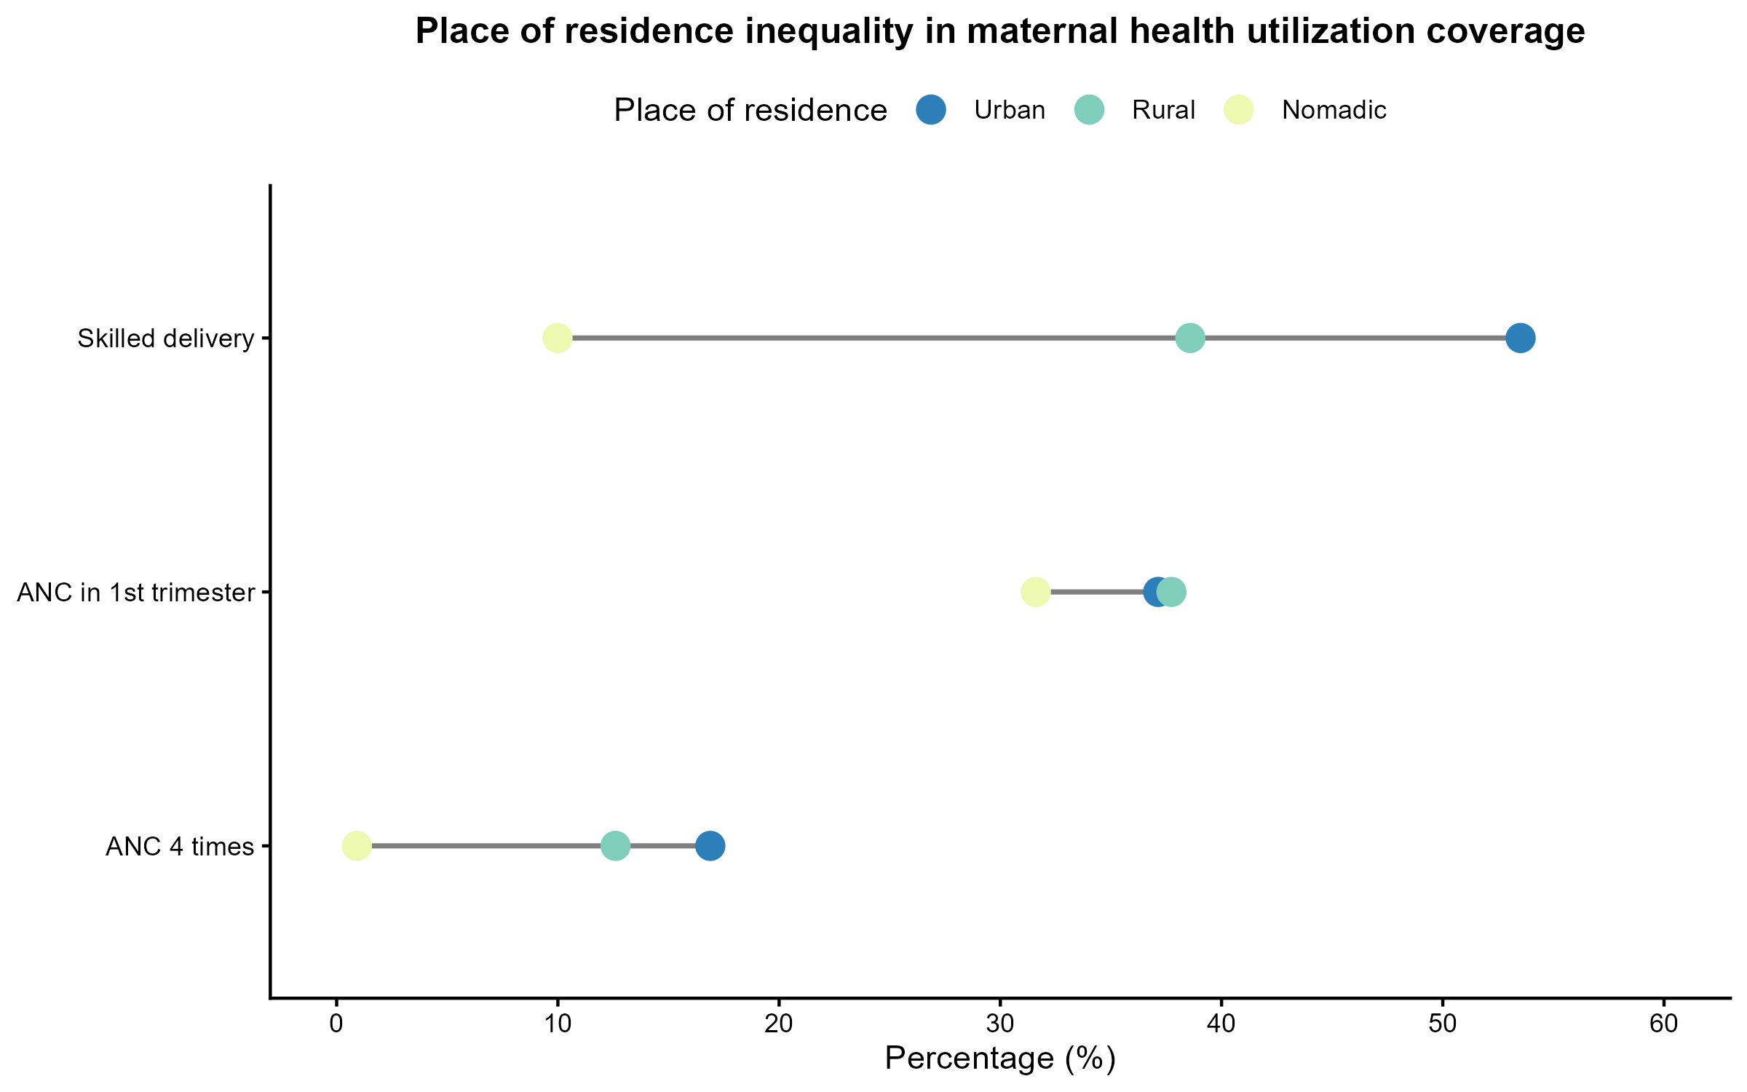
Equity of maternal health services
There is a significant inequalities in maternal health services, with higher education, urban residency, and wealth leading to better access to skilled delivery and antenatal care.
Rural and low-income women face substantial barriers in obtaining these services.

Slide 6
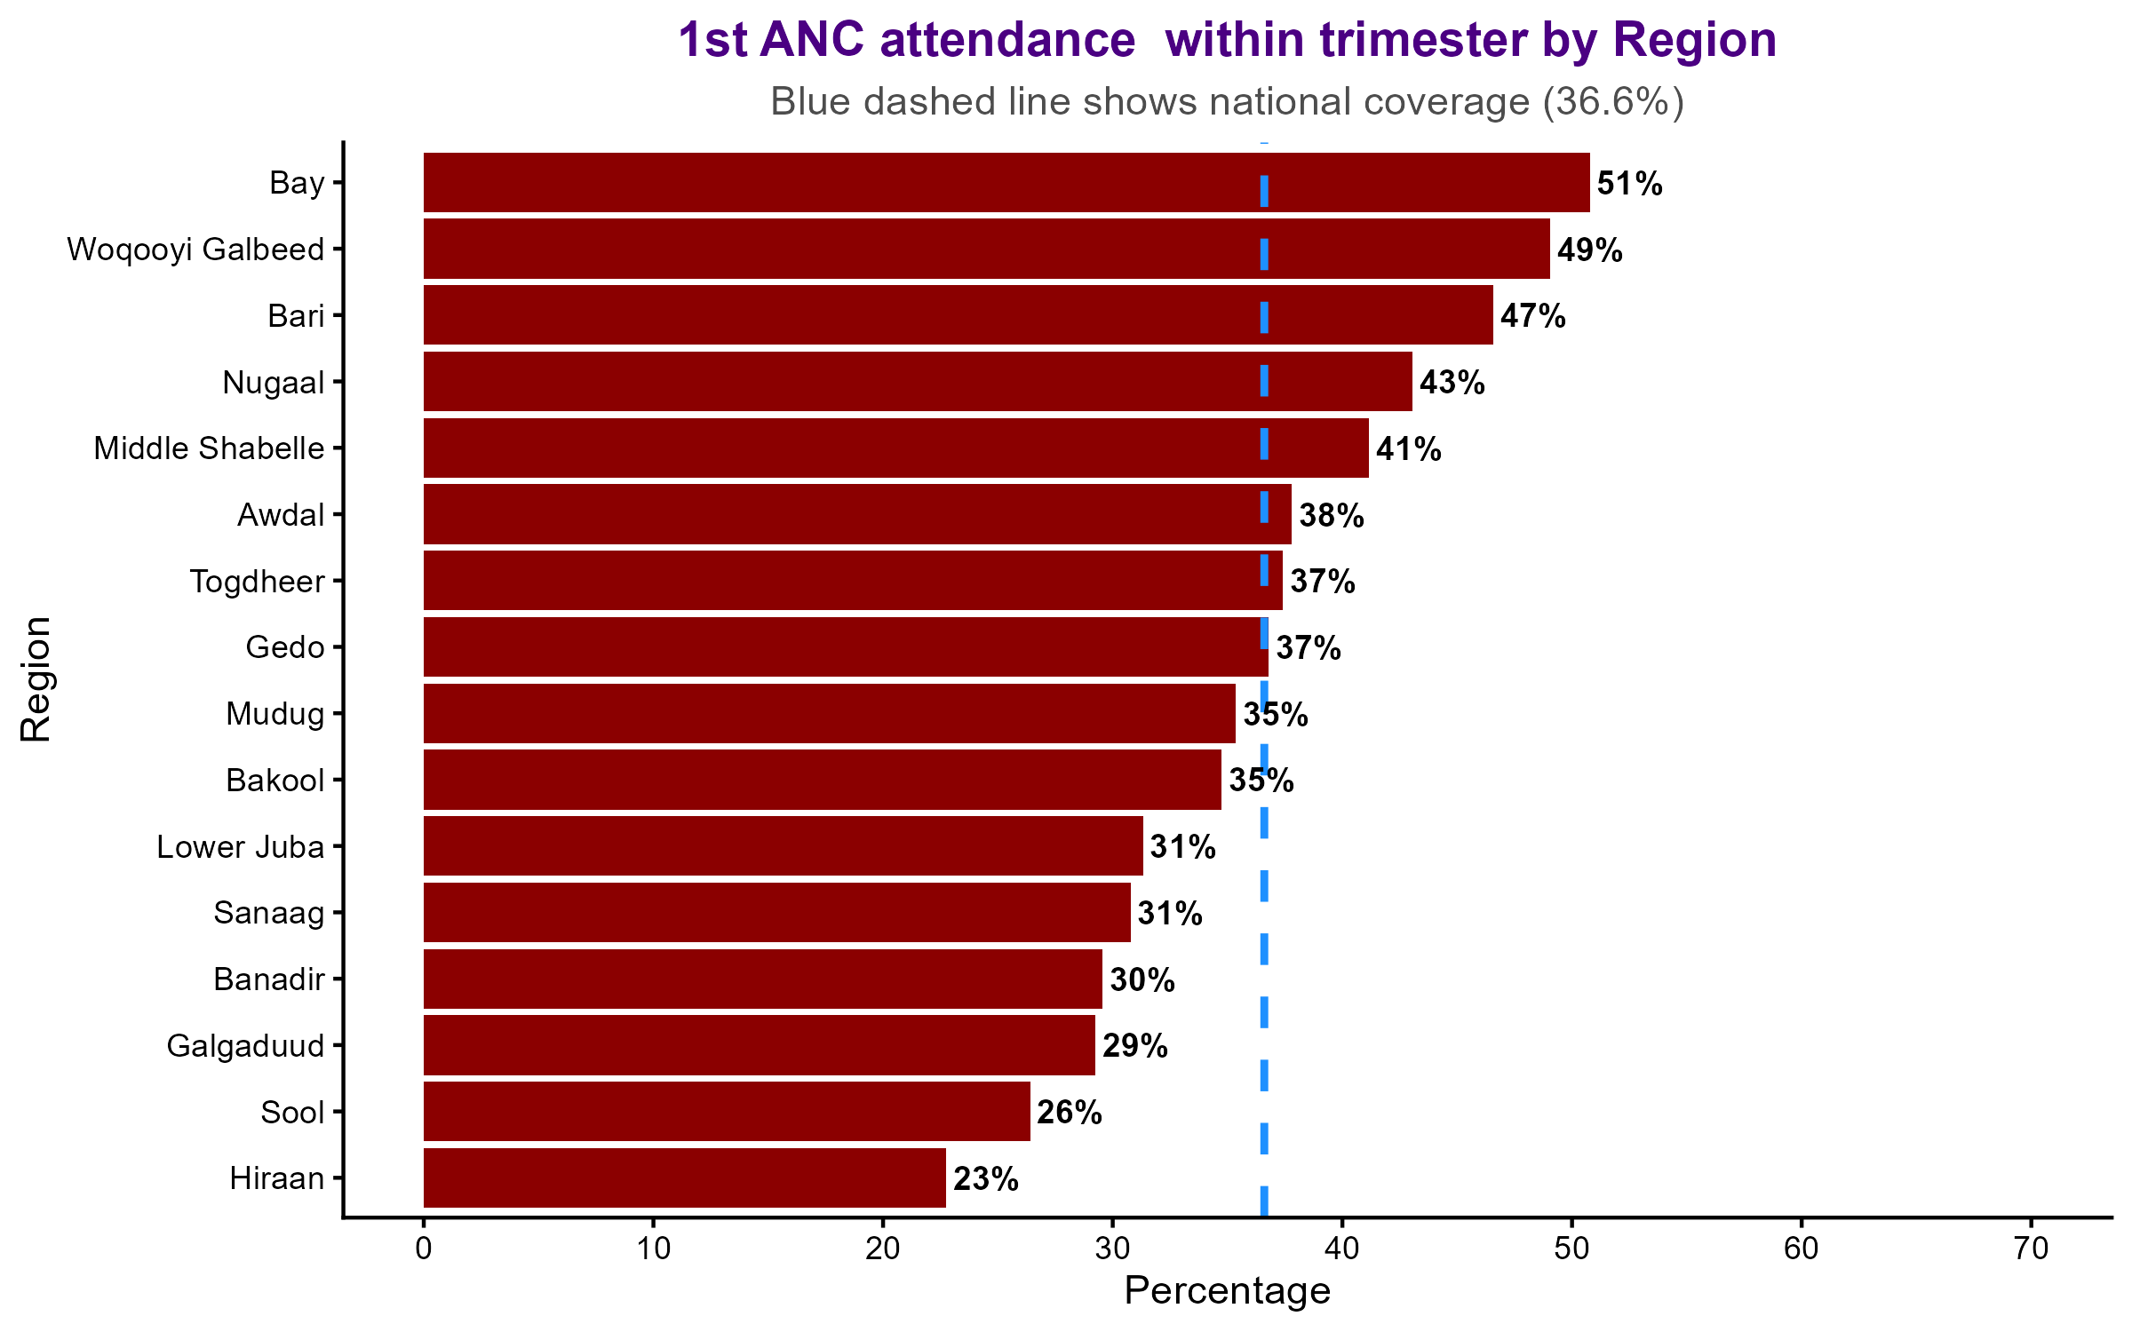
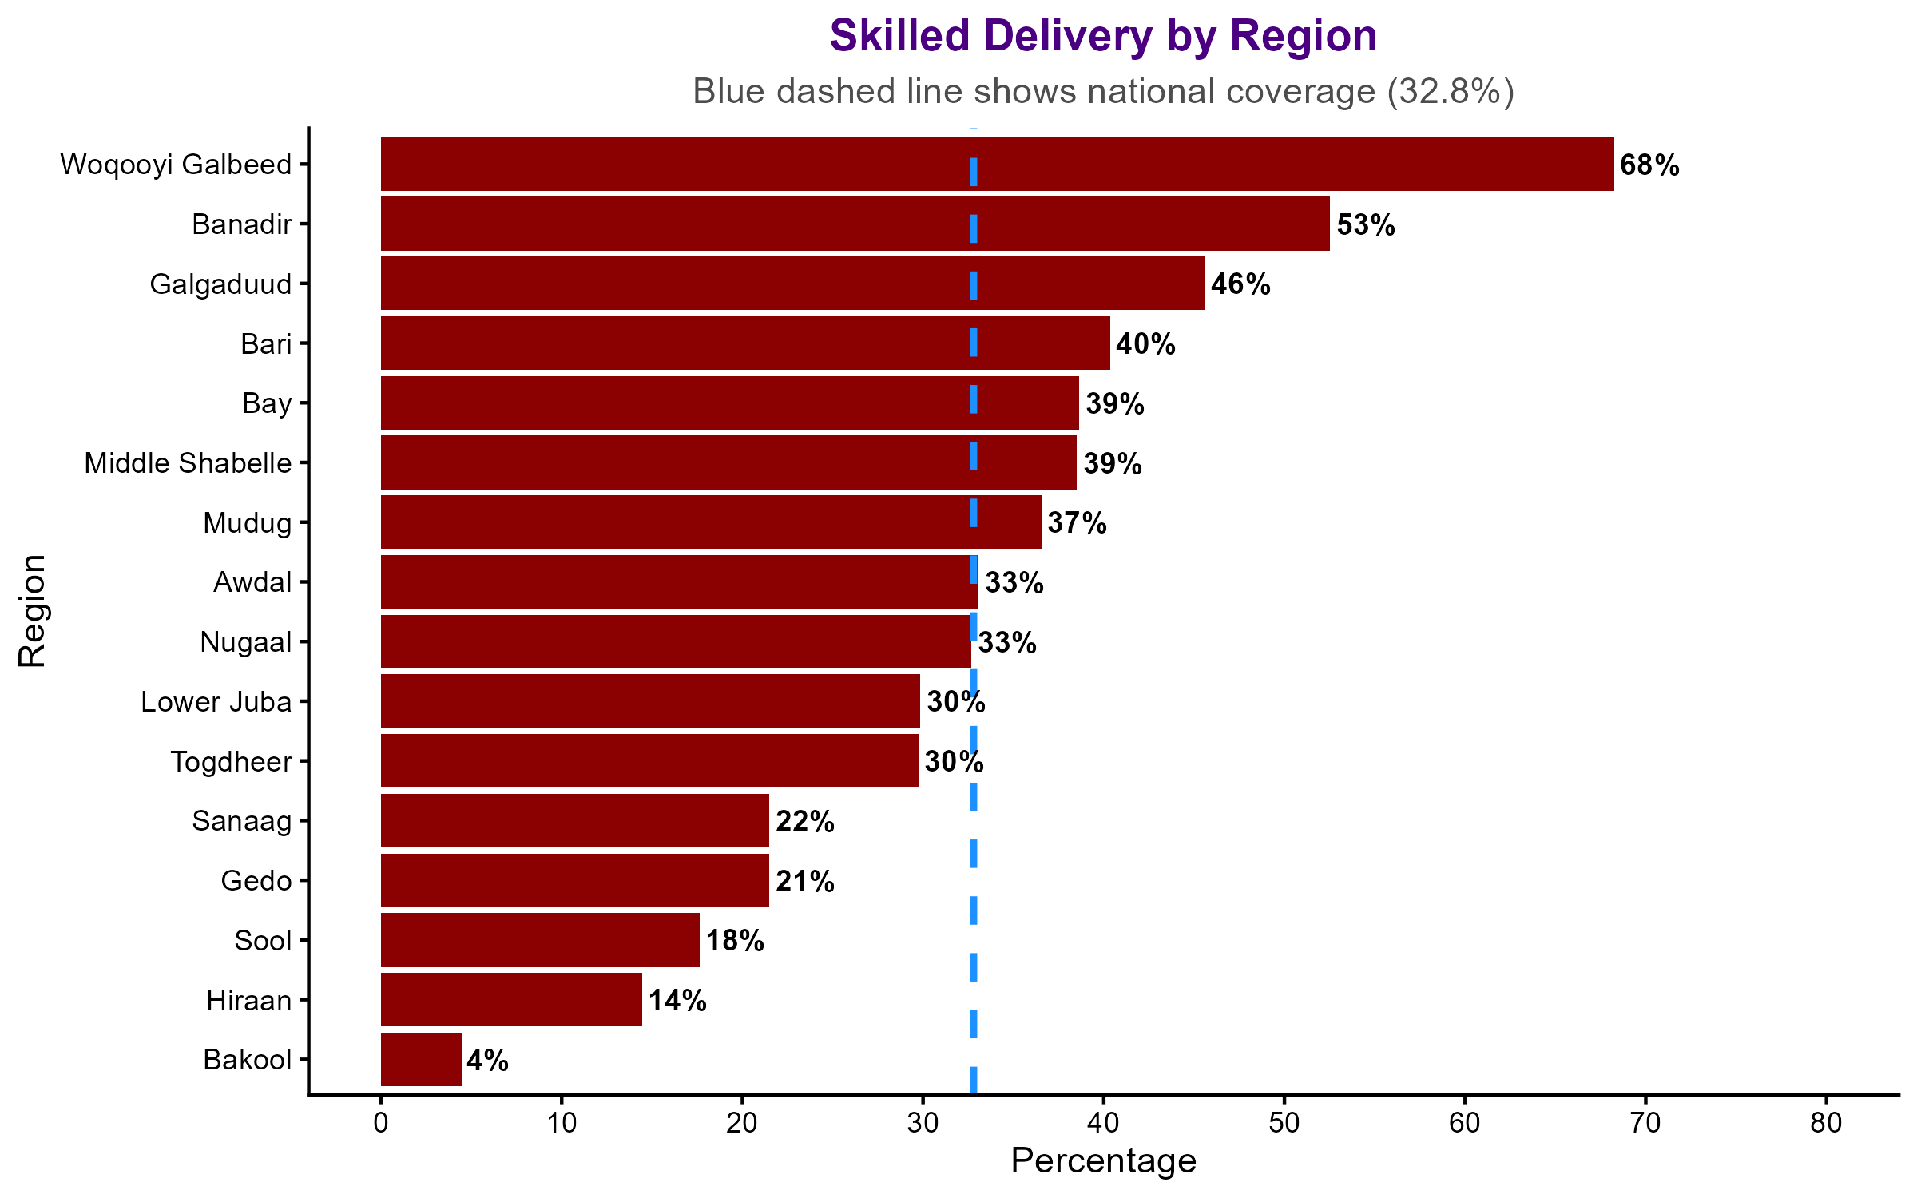
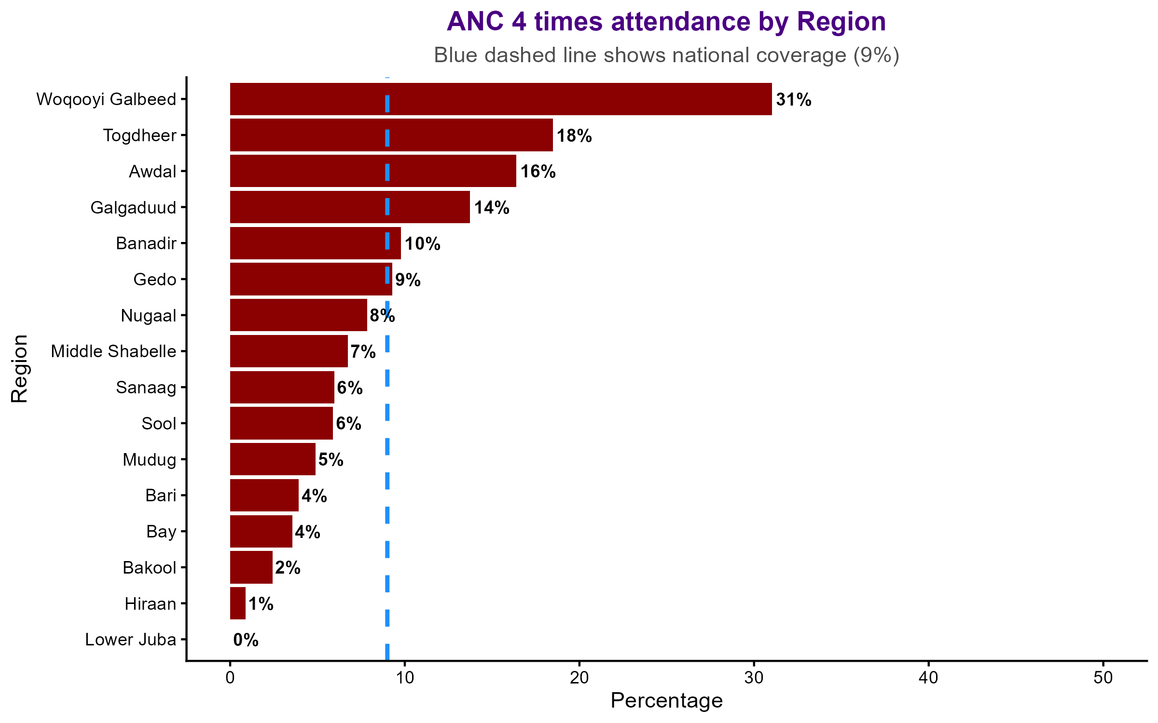
Maternal health service coverage by region
Regional disparities in maternal healthcare
Maternal health access in all regions is lower that the expected national and global targets

Slide 7
Aren’t the lower coverage estimates leading to high cases of maternal and perinatal mortality?
Perinatal mortality per 1000 births
Maternal mortality per 100,000 births

Slide 8
What is causing neonatal tetanus outbreak?
Low utilization of ANC???
What about infection control within the health facility?

Slide 9
Conclusion
Low Utilization Rates of maternal and newborn
Equity Gaps
Regional Disparities
High institutional maternal and perinatal mortality
  Possibilities of underreporting
Neonatal tetanus
  Besides Low ANC attendances, Infection control could also be an issues
Questions
  How do we improve access to maternal and newborn services ?
  How do we address the issues of infections ?
  Which hard to reach areas should we target ?

Slide 10
THANKS

