Slide 1




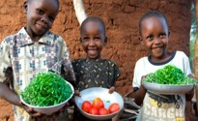
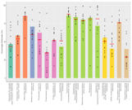

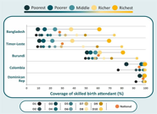
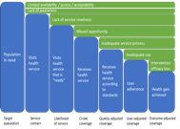
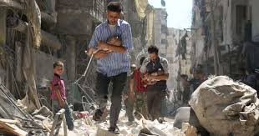
Measuring Universal Health Coverage in MNCH services in Somalia: using Composite Coverage Index (CCI)"
Presenter: Mr. Jamal Warsame

Slide 2
Background
Somalia faces one of the world’s highest maternal, neonatal, and under-five mortality rates.
The Composite Coverage Index (CCI) assigns equal weight to maternal and child health services.
It Facilitates systematic monitoring of health service coverage over time
We compute CCI for MNCH services in Somalia and assess national and subnational levels of service coverage

Slide 3
Methods and materials
Used the 2020 (SDHS) for analysis.
Harmonized indicators based on standardized definitions and methodologies developed by the Countdown 2030 initiative.
Applied the Composite Coverage Index (CCI) as a summary measure of MNCH service coverage.

Slide 4
Cont..
Continuum of Care Components:
CCI combined 8 key intervention indicators, categorized into 4 service areas:
Family Planning (demand satisfied with modern methods)
Maternal and Newborn Care (4+ ANC visits, skilled birth attendance)
Immunization (BCG, DPT3, measles)
Treatment of Childhood Illnesses (ORS for diarrhea, care-seeking for ARI)
Component
Maternal & Newborn
ANC1, fist trimester ANC4 (ANC4+, Skilled birth attendance
Immunizations
BCG, Measles (MSL), DPT1 DPT3 (DPT is double-weighted)
Excluded indicators | Reasons
Family planning | No sufficient Data in the dataset.
ORT | No sufficient Data in the dataset.

Slide 5
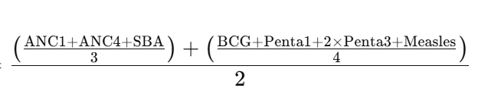
Formula for calculation

Slide 6
Result

Slide 7
Overall composite coverage index.

Slide 8
Conclusion
Overall CCI of maternal and immunization services performance remains low, with wide regional disparities across Somalia.
Maternal health services had a higher median CCI (28.2) than immunization services (22.8), indicating slightly better coverage.
Regions with the lowest CCI scores:
Hiraan, Awdal, Lower Juba.
Highest CCI performers:
Woqooyi Galbeed and Banadir Region.

Slide 9
Implications
Targeted interventions are need by scaling up high-impact interventions in line with EPHS.
Identifying evidence-based interventions to increase coverage
Prioritize underserved Regions (rural, nomadic, IDPs).

Slide 10
ASANTE SANA
MAHADSANIDIIN
THANK YOU
SHUKRAN
شكراً

